Slide 1
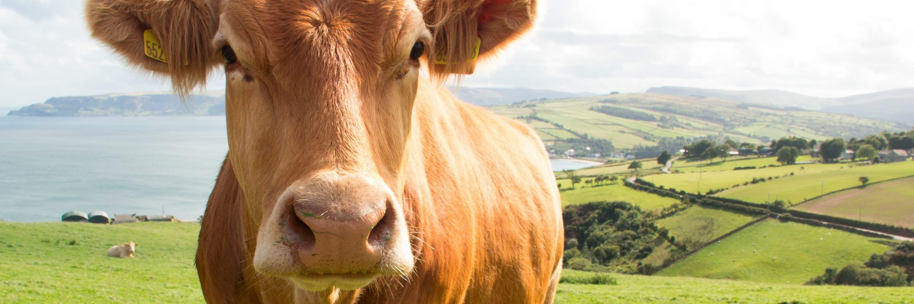

Image compression algorithms for the livestock industry

Slide 2
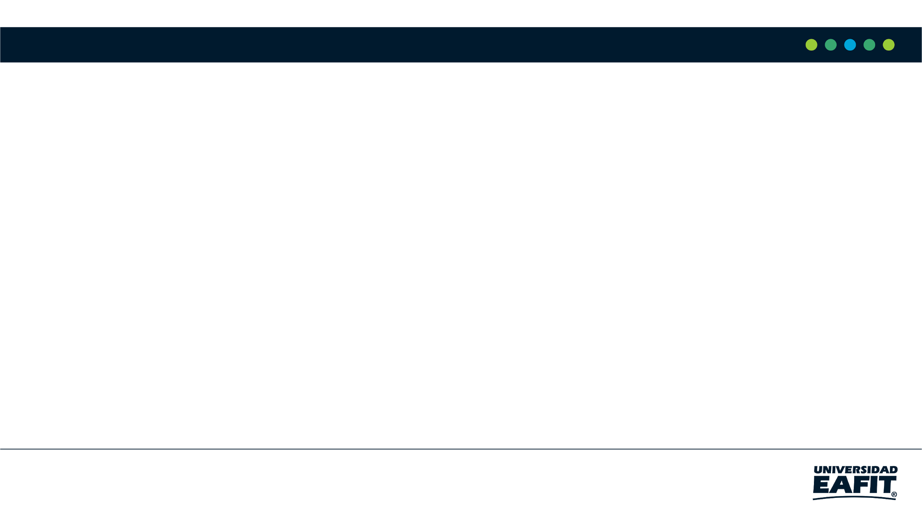
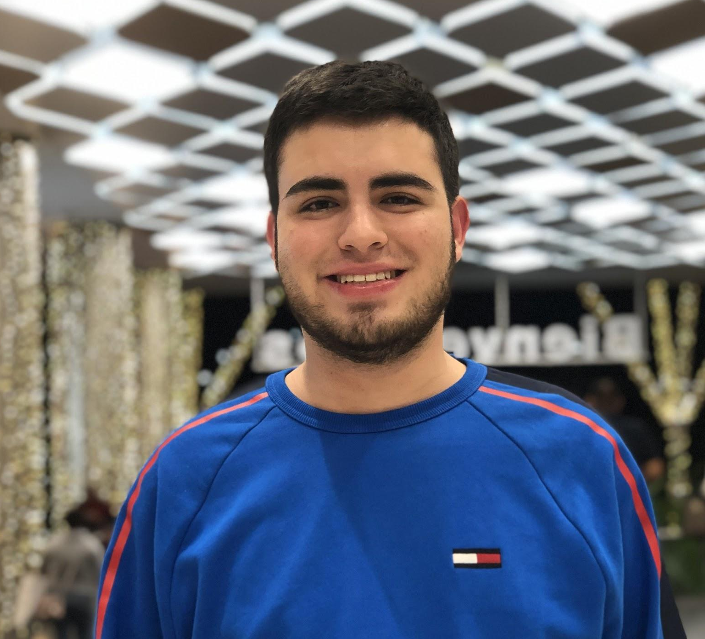
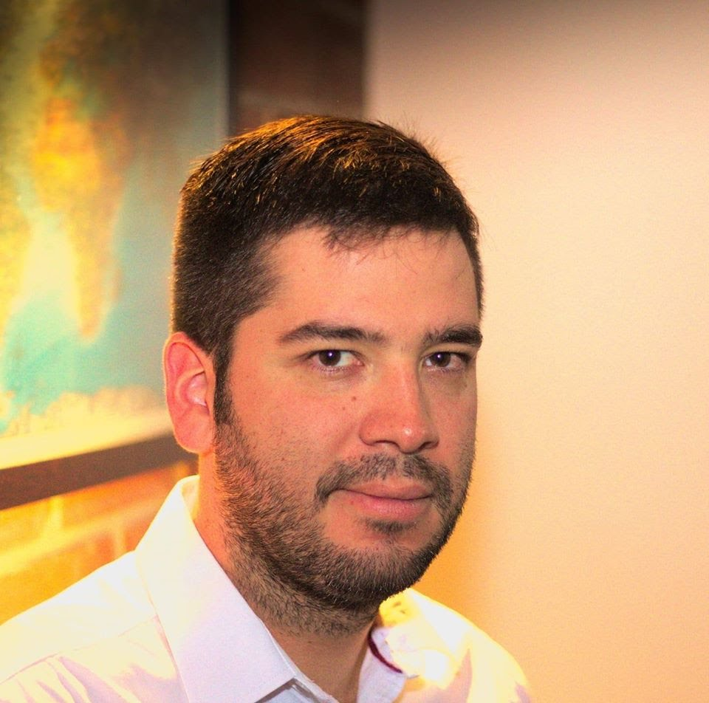
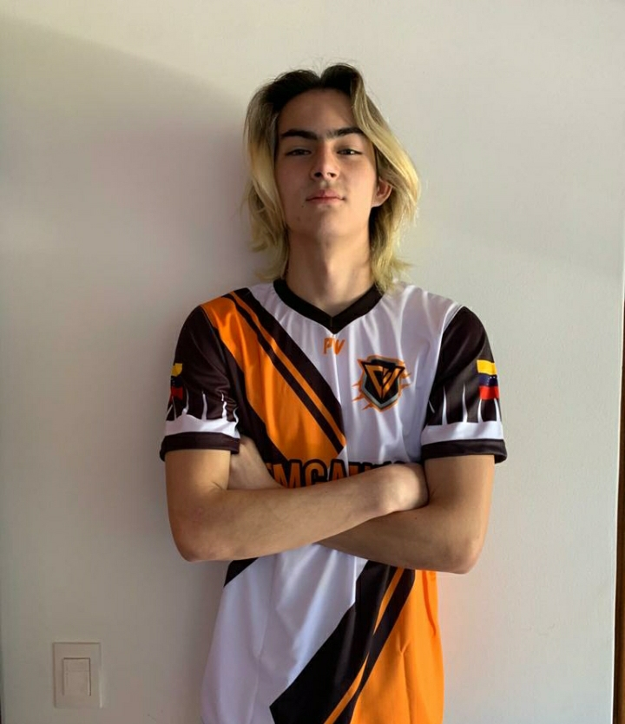
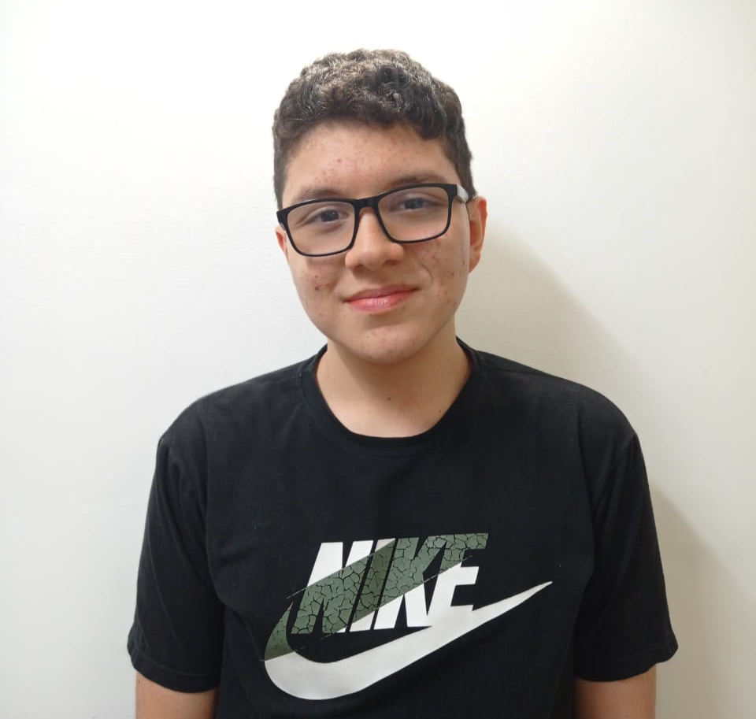

Team Presentation
Esteban Bernal Correa
Juan Manuel Garzón
Simón Marín
Mauricio
Toro
https://github.com/StipGod/ST0245-002/tree/main/ST0245-Plantilla-master/proyecto

Slide 3
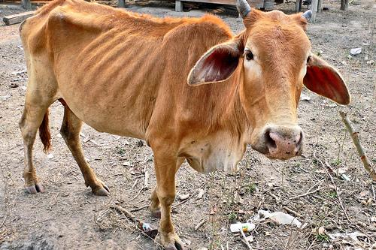
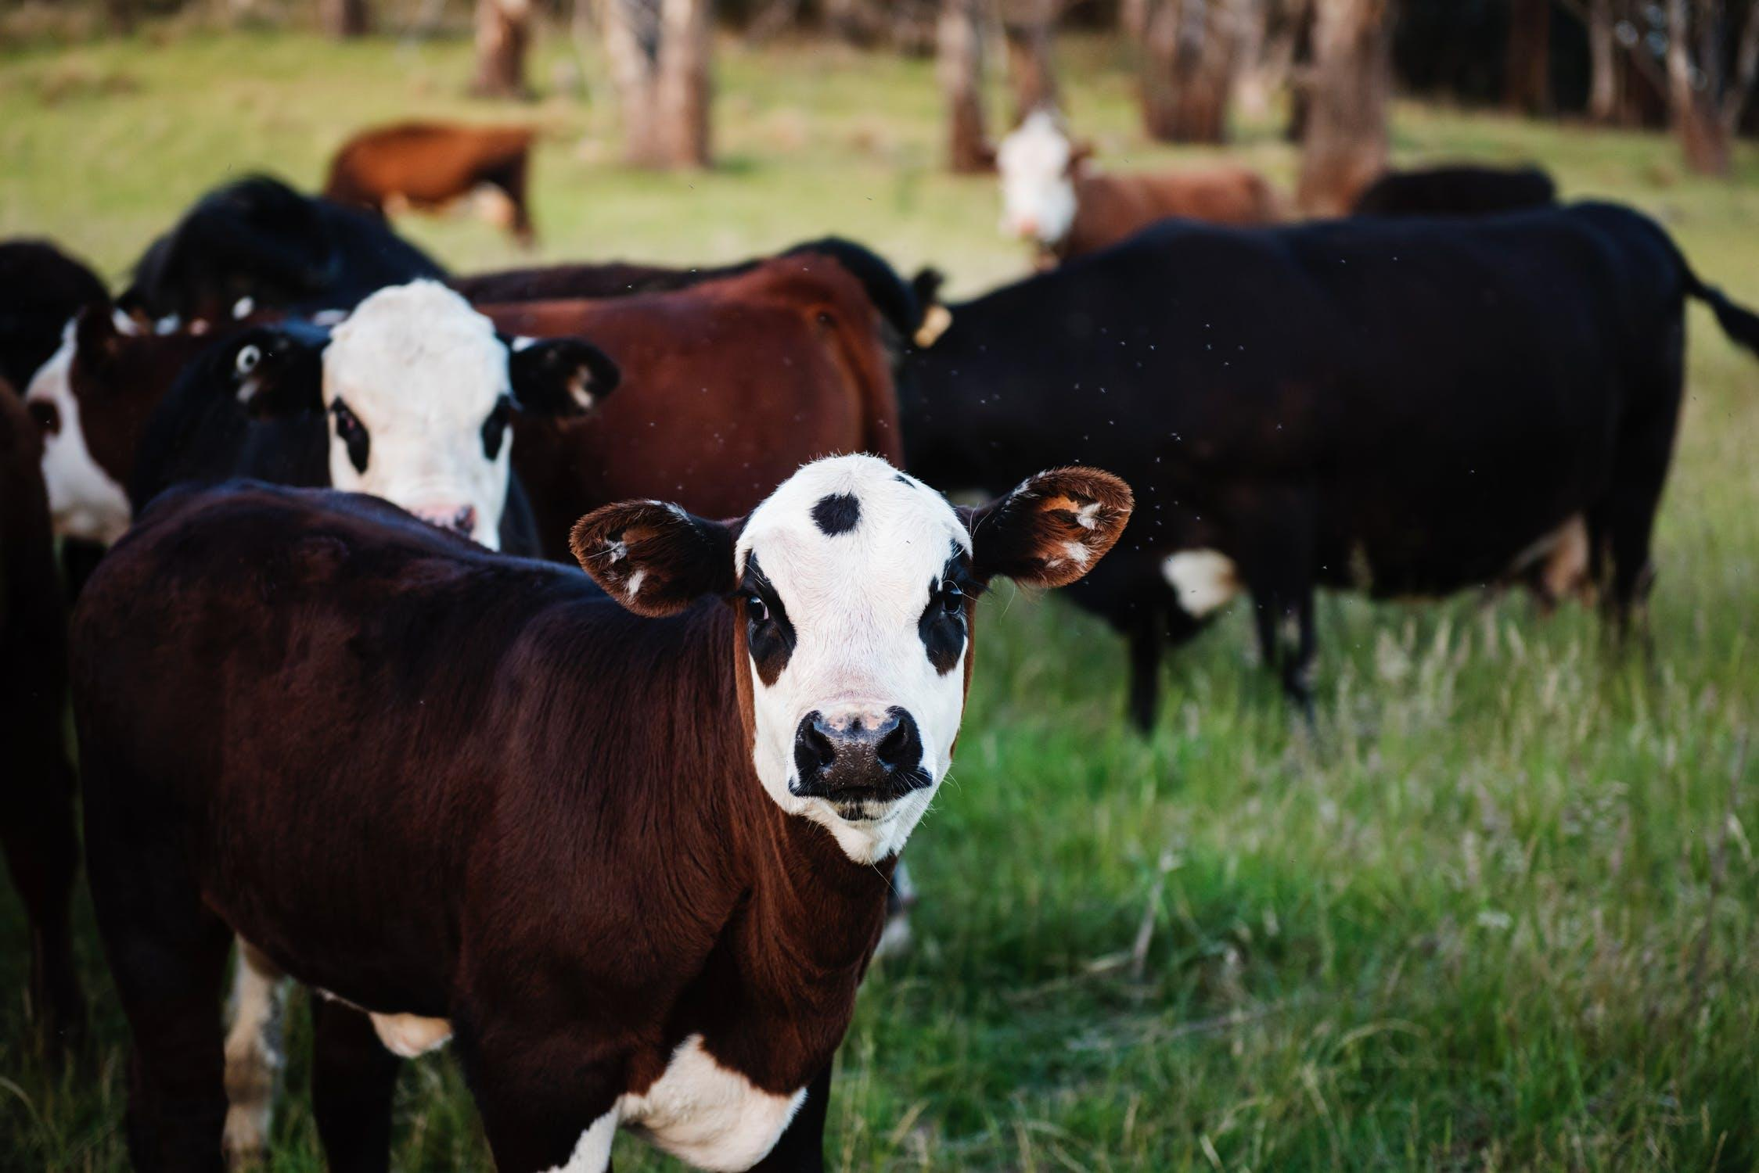
Training Process
Neuronal net
Sick livestock images
Clasification algorithm
Clasification model
Healthy livestock images

Slide 4
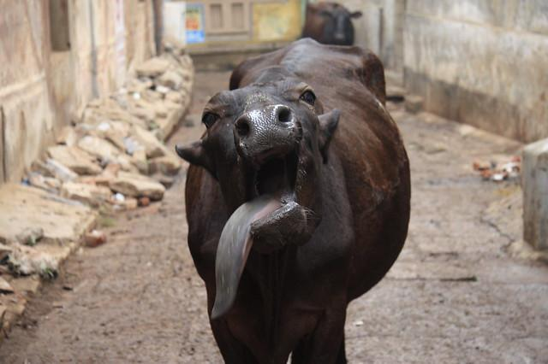
Validation process
NNS
Sick
Cattle image
Nearest Neighbor
Output
Clasification Model

Slide 5
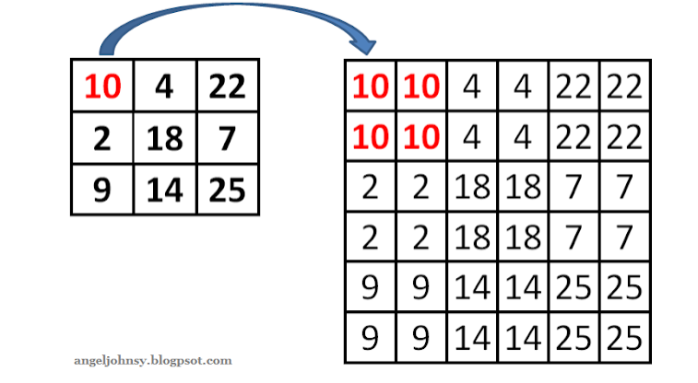
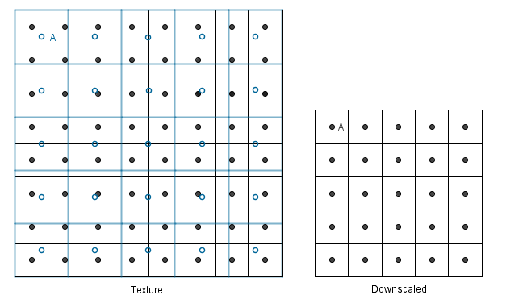
Design of the compression algorithm
Dowscaled
Upscaled

Slide 6
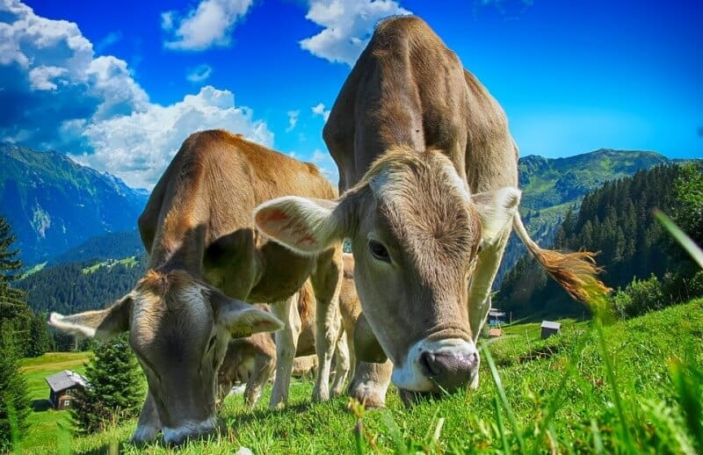
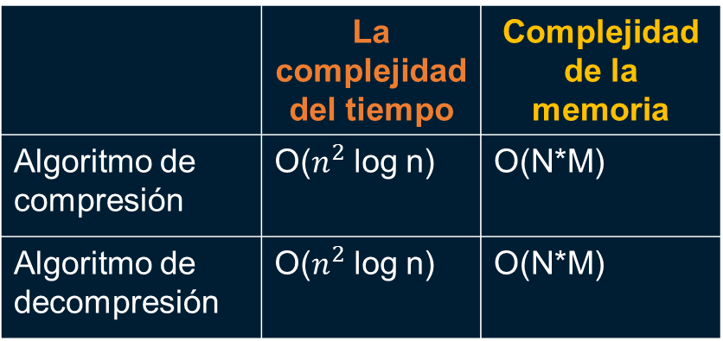
Complexity of the compression algorithm
 | La complejidad del tiempo | Complejidad de la memoria
Algoritmo de compresión | O($n^{2}$ log n) | O(N*M)
Algoritmo de decompresión | O($n^{2}$ log n) | O(N*M)
…….

Slide 7
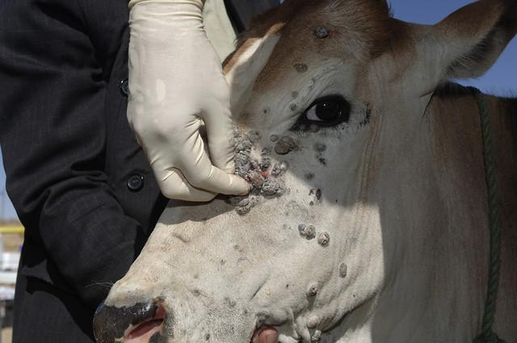
Tasa de compresión promedio
 | Compression rate
Healthy cattle | 100 : 1
Sick cattle | 98 : 1
Average compression rate for healthy cattle and diseased cattle.

Slide 8
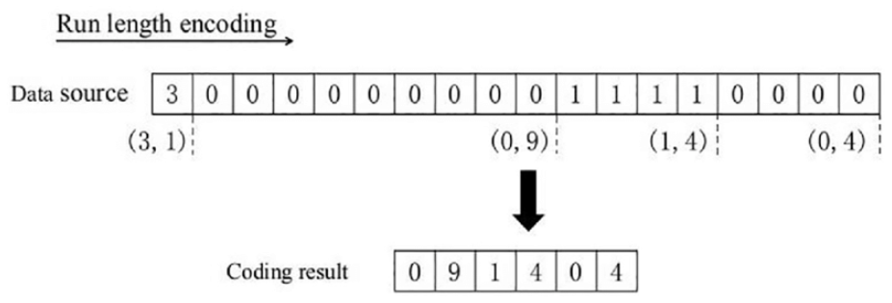
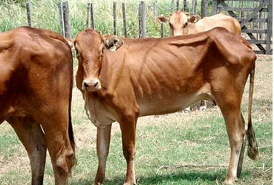
Design of the compression algorithm

Slide 9
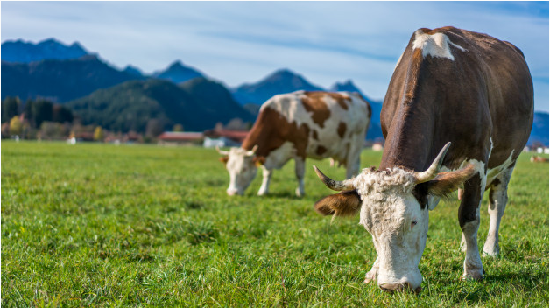
Proceso de validación
LZ77
Healthy
Cattle image
LZ77
Clasification Model
Output

Slide 10
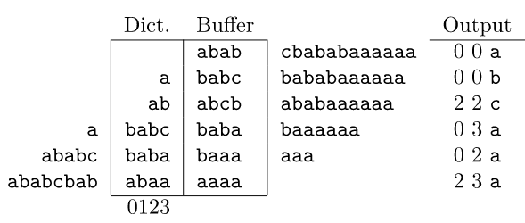
Design of the compression algorithm
Encoder

Slide 11
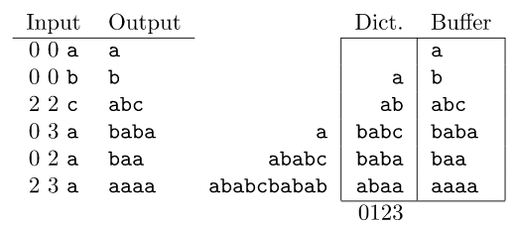
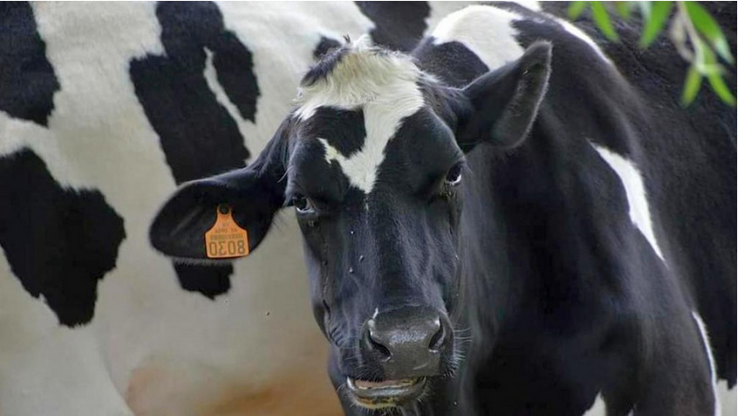
Design of the compression algorithm
Decoder

Slide 12
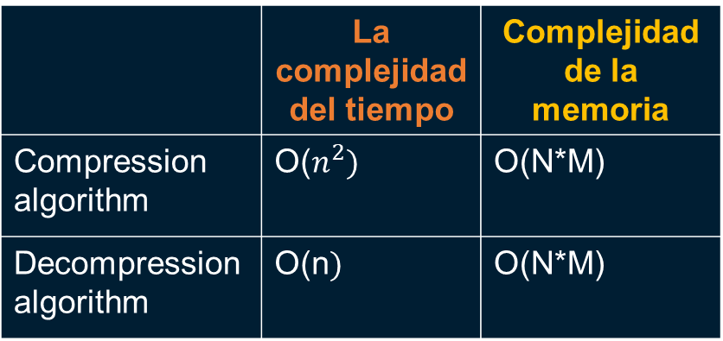
Complexity of the compression algorithm
 | La complejidad del tiempo | Complejidad de la memoria
Compression algorithm | O($n^{2})$ | O(N*M)
Decompression algorithm | O(n$)$ | O(N*M)

Slide 13
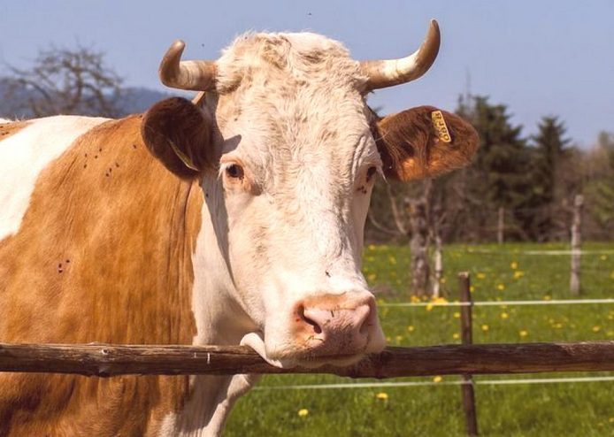
Tasa de compresión promedio
 | Compression rate
Healthy cattle | 20 : 15
Sick cattle | 20 : 15
Average compression rate for healthy cattle and diseased cattle.

Slide 14
Proceso de validación
RLE
Healthy
Cattle image
Run-length encoding
Clasification Model
Output

Slide 15
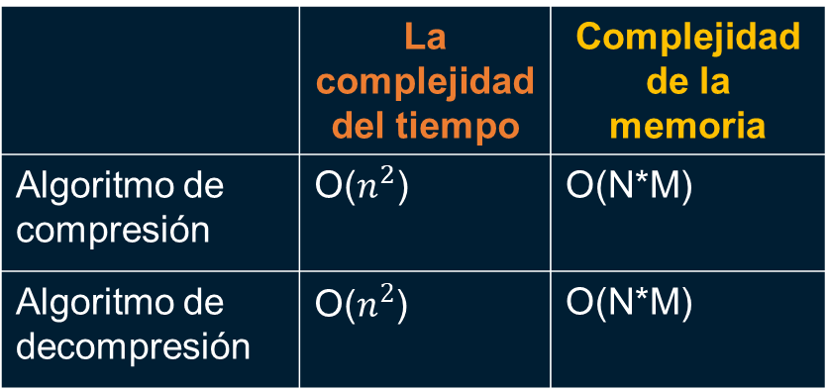
Complexity of the compression algorithm
 | La complejidad del tiempo | Complejidad de la memoria
Algoritmo de compresión | O($n^{2}$) | O(N*M)
Algoritmo de decompresión | O($n^{2}$) | O(N*M)
…..

Slide 16


Consumo de tiempo y memoria
Time consumption
Memory usage

Slide 17
Tasa de compresión promedio
 | Compression rate
Healthy cattle | 20 : 12
Sick cattle | 20 : 12
Average compression rate for healthy cattle and diseased cattle.

Slide 18
Thank you!.
All the authors would like to thank the Vice-rectory for Discovery and Creation, of the EAFIT University, for their support in this research.

